Slide 1
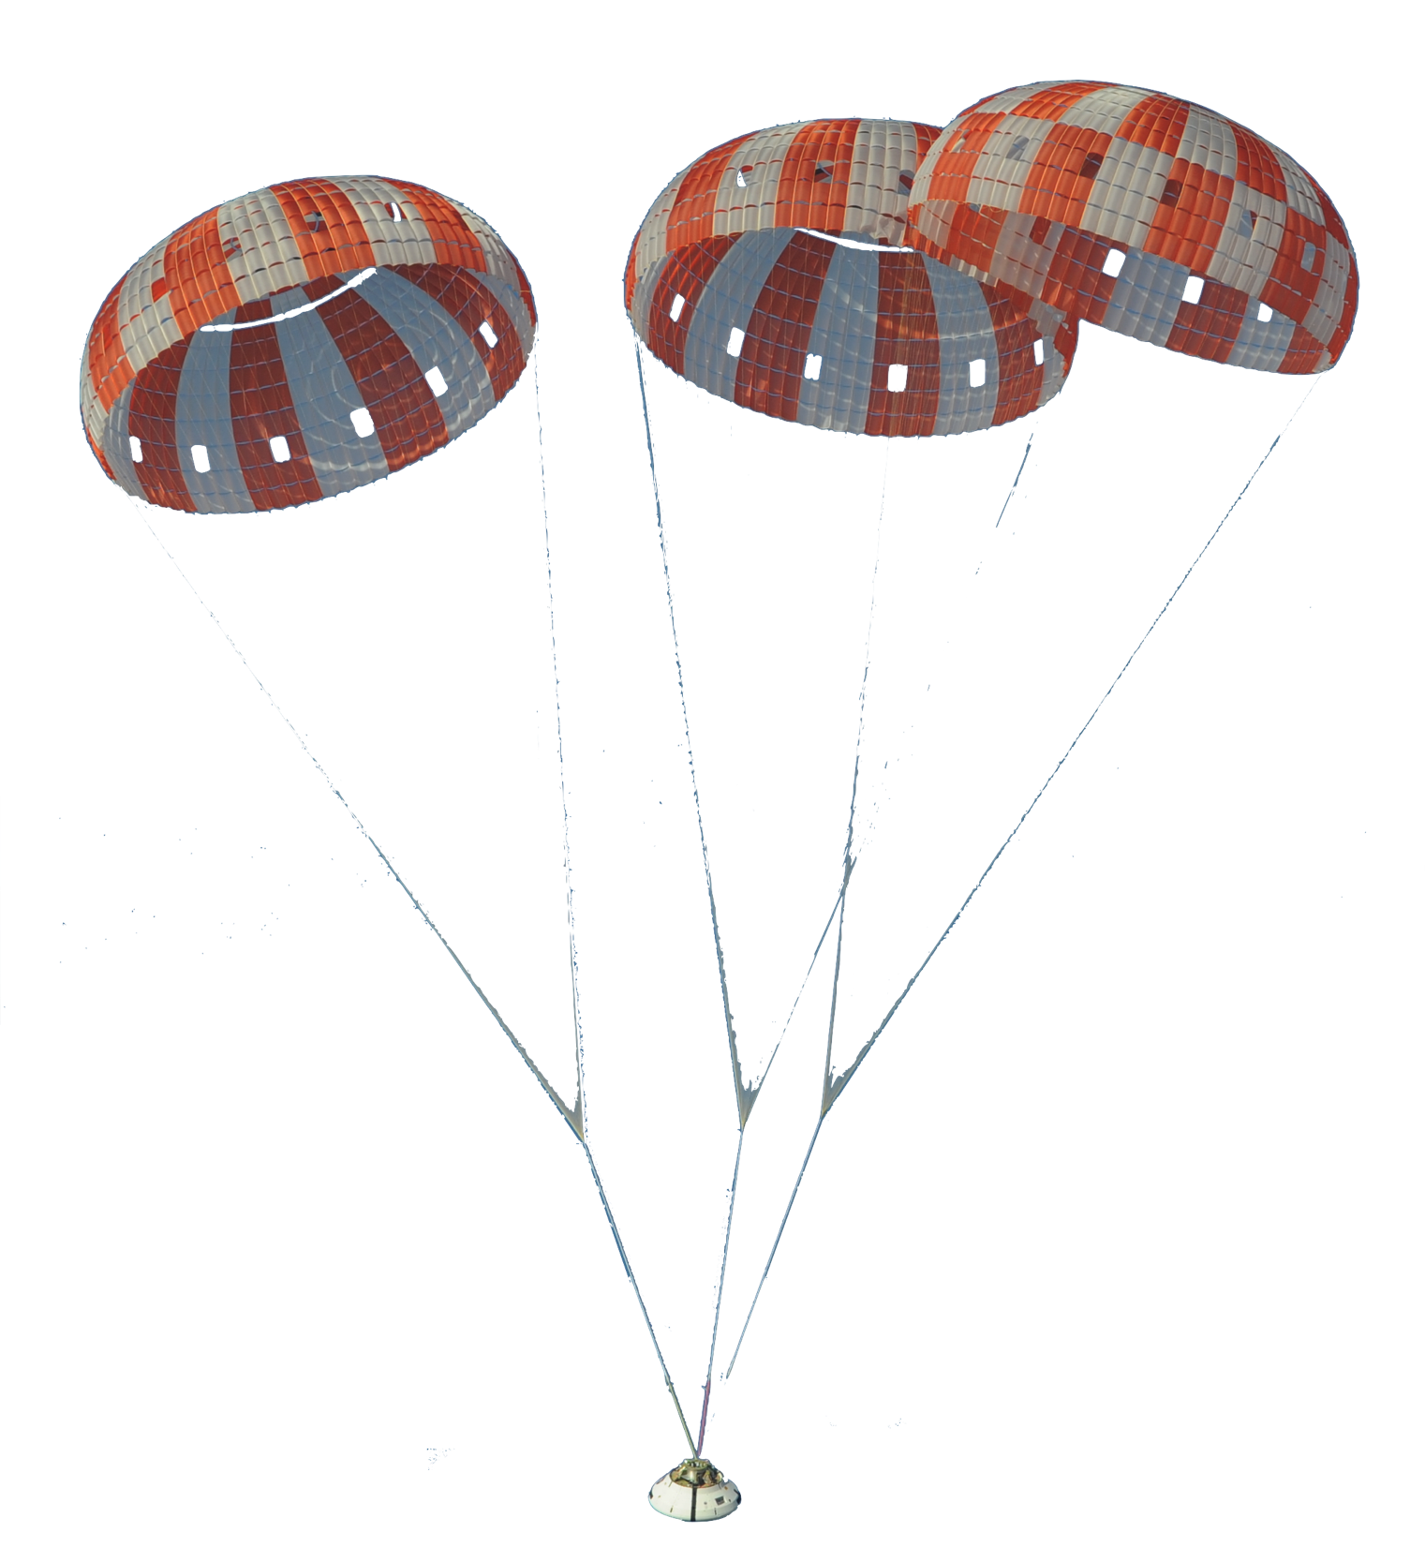
RANS Turbulence Modeling Sensitivity of Parachute-like Bodies
Logan Halstrom
3/16/17

Slide 2
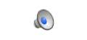
Motivation
Orion parachutes can exhibit pendulum motion
During two-chute failure mode
Unstable motion
Potential hazard to crew/vehicle

Slide 3
Motivation
Use CFD to model dynamic motion
High-fidelity, rigid geometry model

Slide 4
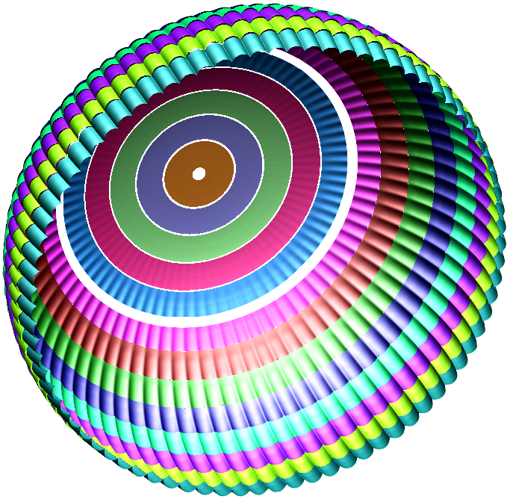
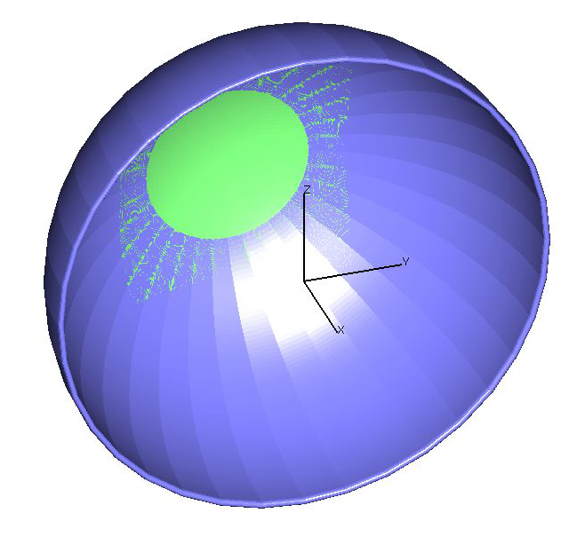
Goals
No turbulence model study has been performed for chute
Run simulation with SST and SA models, compare results
Develop simple test model
Coarse grid, low-fidelity geometry: reduce computational demand
Future use as sandbox for parachute simulations
2,000,000,000 points
3,200,000 points

Slide 5
OVERFLOW CFD Tool
Structured, overset grids
Interpolation between overlapping grids
Implicit, Navier-Stokes, finite-differencing
SSOR, BDF2, etc
Dual-time stepping
Unsteady solution from physical time stepping
Converge between time steps with steady-state “sub”-iteration
Helps pre-condition low-Mach cases
Multi-species gas continuity equation capability
High-Mach flows (super and hyper sonic)
Reactive flows (thrusters, etc) but no chemistry
Geometry Manipulation Protocol
Easy relative grid motion/interpolation
Primary reason for using OVERFLOW for this simulation

Slide 6
Turbulence Models
Spalart-Allmaras (SA)
One-equation: solve for viscosity-related variable (TKE)
2nd-order Backward Differentiation Formula in OVERFLOW
Shear-Stress Transport (SST)
Combines best characteristics of traditional two-equation models
Convection equation: account for energy of turbulence
Dissipation equation: account for scale of turbulence
Use k-ω for inner boundary layer
No need for damping functions
Use k-ε for freestream
Not as sensitive as k-ω
Successive Symmetric Over Relaxation (SSOR) in OVERFLOW

Slide 7
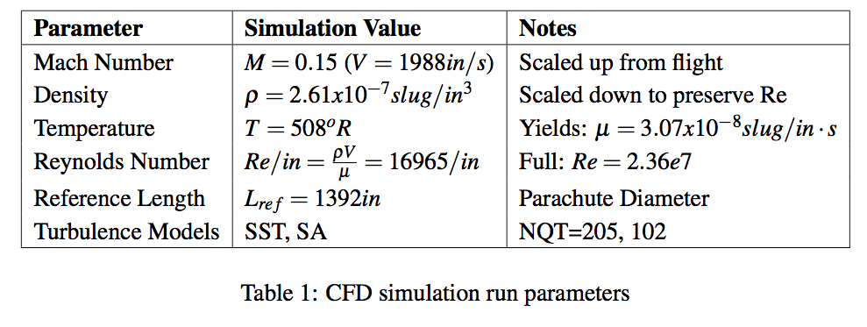
Run Parameters
Match hemisphere run parameters to high-fidelity chute
Match flight parachute geometry scale (Lref)
Scale up flight Mach number x5 (enhance low-Mach convergence)
Preserve flight Reynolds number

Slide 8
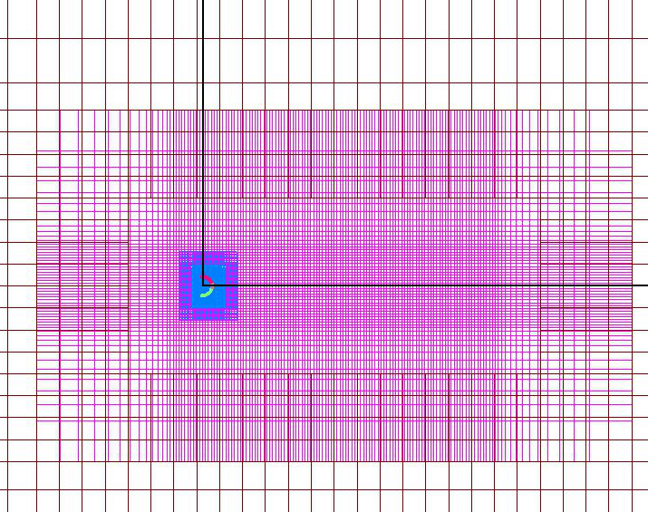
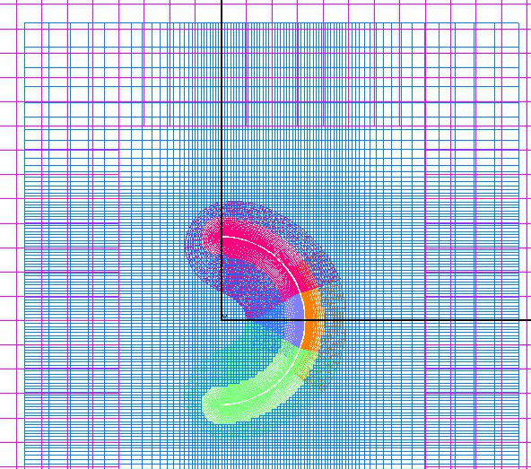
Grid Development
Use same overset grid strategies as high-fidelity chute
Cascading box grids propagate flow around body
Chute box compensates for inadequate, concave near-body grids

Slide 9
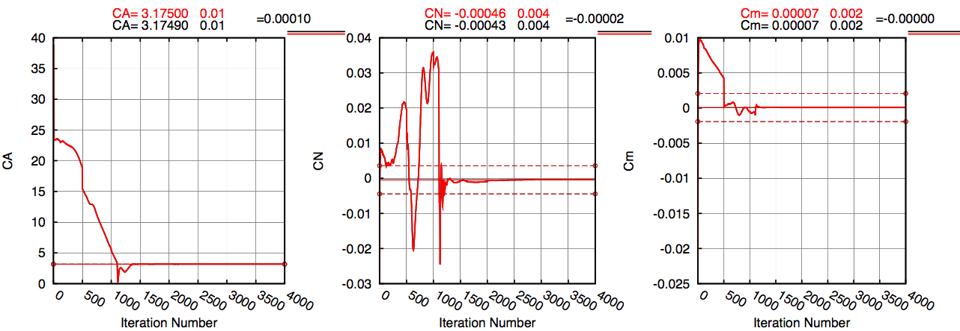
Results: Convergence
Co-plot results show nearly identical convergence
One possibility: solution is independent of turb. Model
Another possibility: solution is more dependent on grid

Slide 10
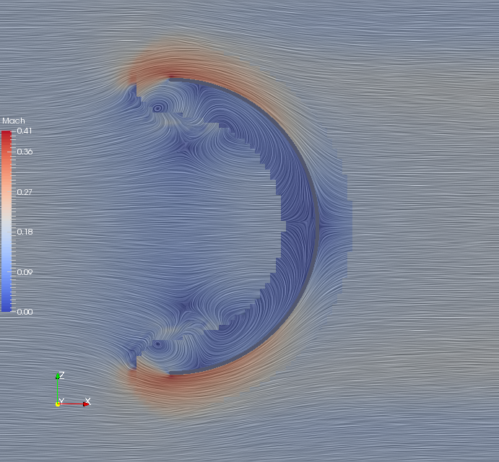
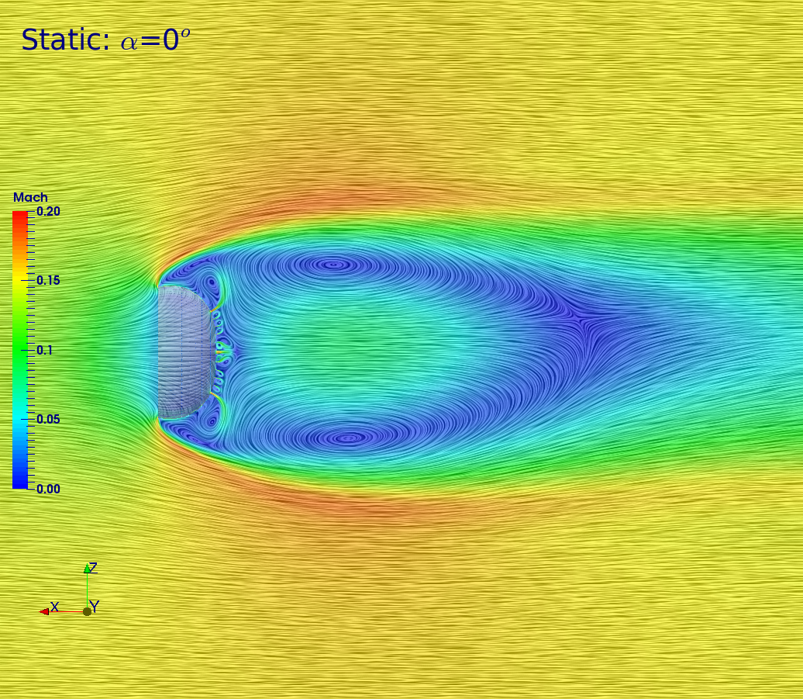
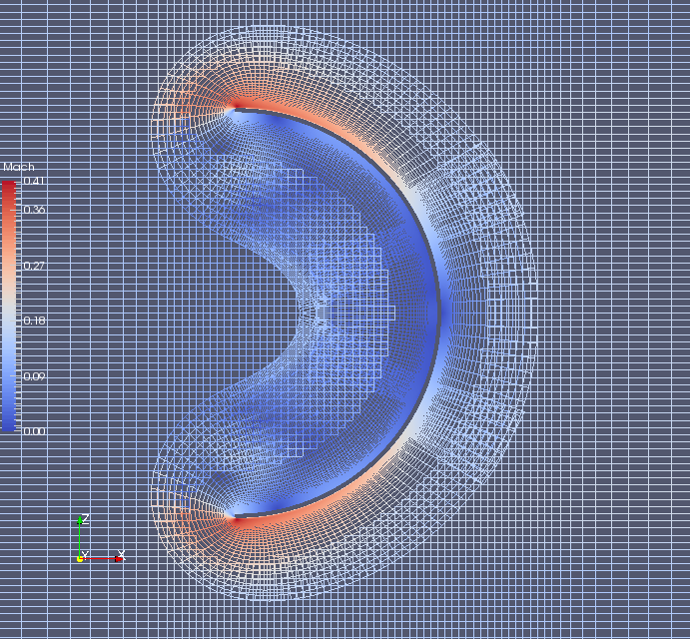
Results: Flow
Grid dependency observable in flow behavior
Flow is better resolved/constrained in near-body grids
Discontinuities at grid interpolation regions
High-fidelity solution
Hemisphere wireframe
Hemisphere solution

Slide 11
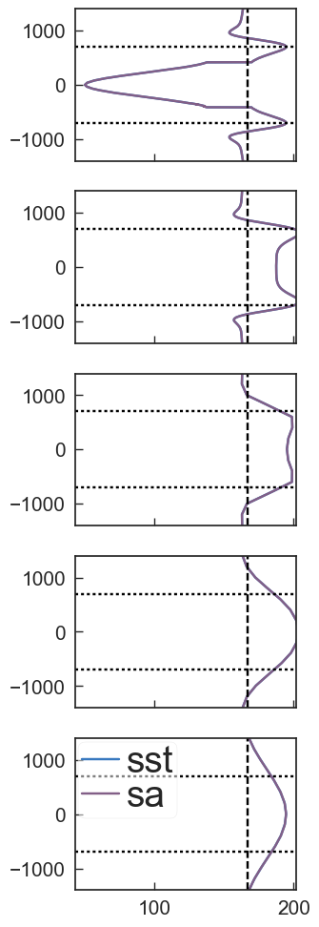
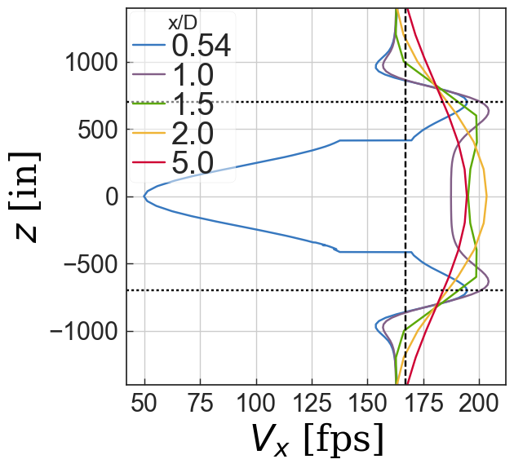
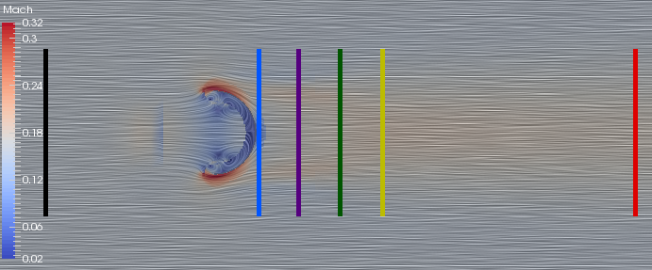
Results: Wake
Sample x-velocity in wake at spanwise stations
Results overlap: no influence from turb. Model
Differencing results reduces to floating point error
Discontinuities due to bad grid interpolation
Drag Coefficient
CFD: 3.2, Experiment (semicircle): 2.3
Possible causes: 2D vs 3D, massive separation, grid
Wake velocity sample locations

Slide 12
Conclusions and Next Steps
Turbulence study inconclusive
Solutions were independent of turbulence model BUT…
Obvious dependency on grid resolution, need refinement studies
Future work
Testbed for 6DoF pendulum simulations
Avenue for further grid refinement and turbulence studies

Slide 13
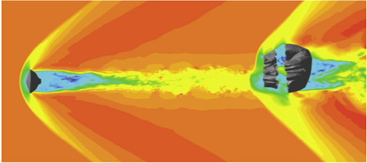
Other Models (Not RANS)
Compressible LES coupled with FSI
Supersonic MSL parachute (Karagiozis, Et al.)
Stretched-vortex model
Flow in cell assumed to result from straight, axisymmetric vortices aligned with local strain

